Slide 1

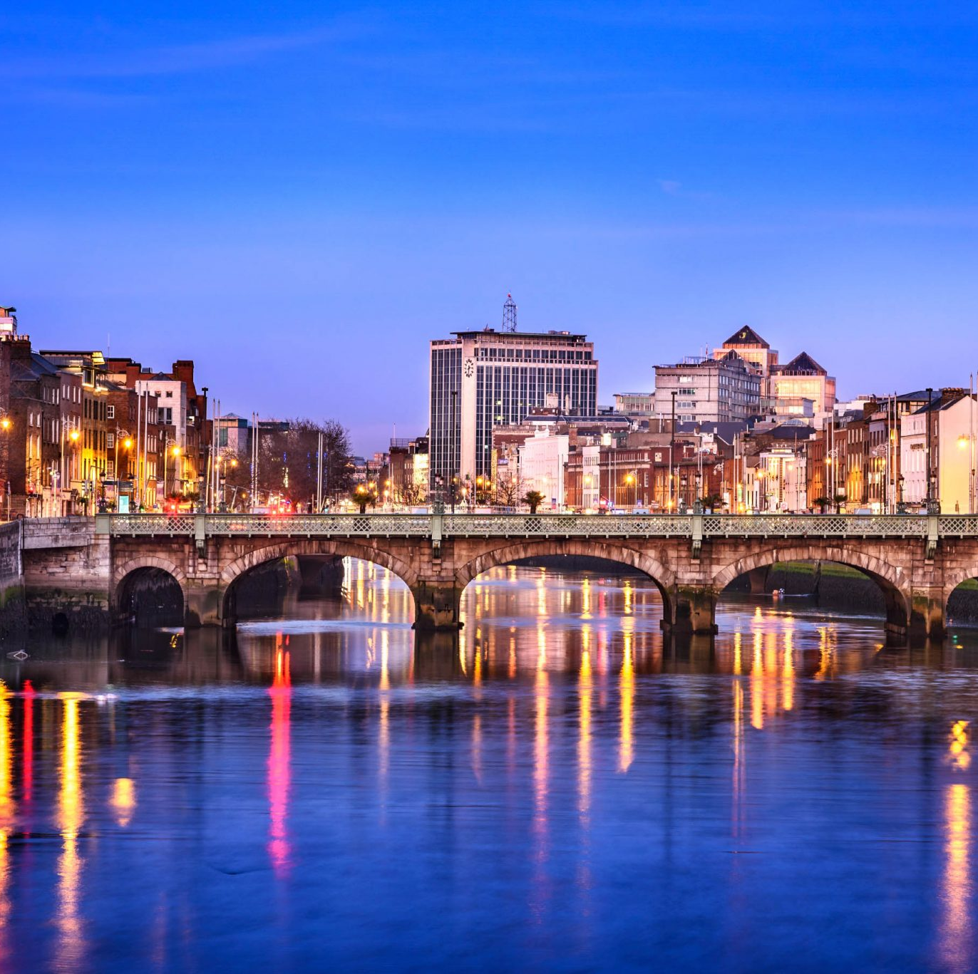
Living in Dublin
September 2026

Slide 2
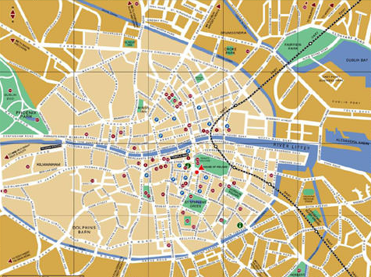
Dublin City
Founded in 988 (allegedly)
Dubh Linn – Black Pool
  Baile Atha Cliath – Town of the hurdled ford
Small, compact city with large suburbs (we call it ‘Town’)
Divided into north and southside by the River Liffey

Slide 3
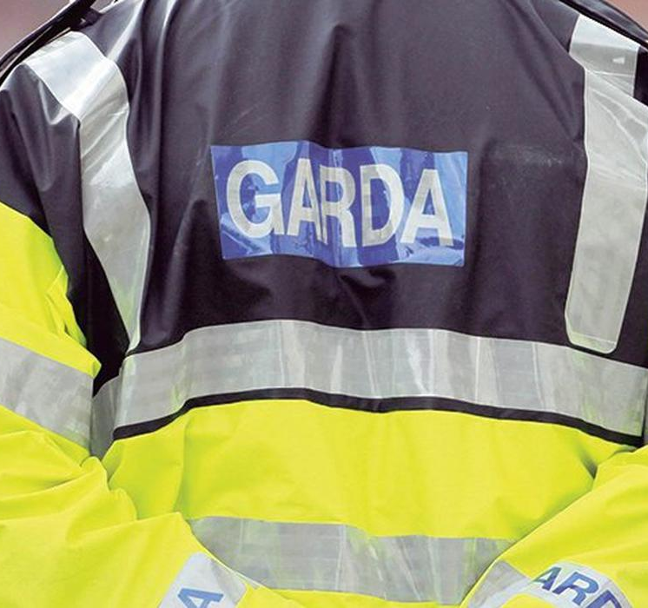
Safety
Overall a safe city
Mind your belongings
Pay attention to your surroundings, particularly at ATMs and entering your apartment/house
Avoid walking alone at night
Irish Police: An Garda Síochána or ‘the Guards’
In an emergency call 112 or 999 (on campus call 01 8961999)
Local Garda Station – Pearse Street – 01 666 9000 (non-emergency)
Safety in the City Talk
15th September, 1.00pm
Goldsmith Hall Lecture Theatre

Slide 4
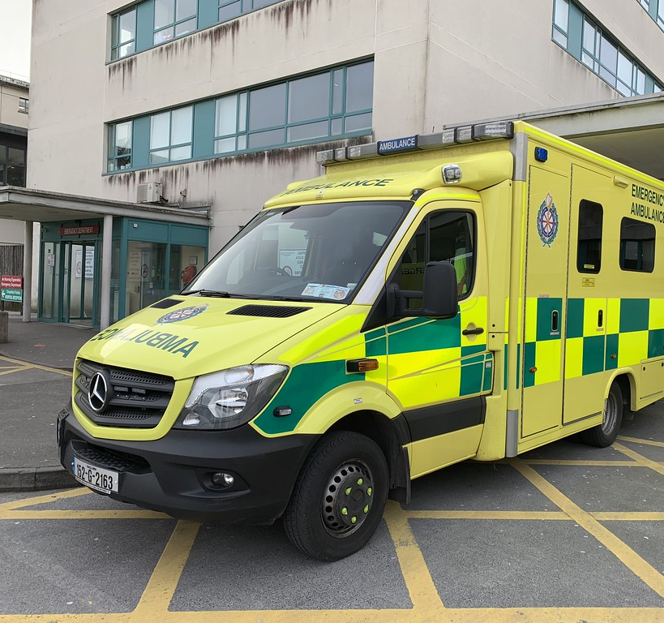
Medical
Hospital care: Health insurance is required for non-EU students. EU students should present their EHIC to receive hospital care
Even with insurance or an EHIC, there is a charge to attend A&E or to call out an ambulance
GP practices/dentists/physiotherapists etc will charge per visit
Local Hospitals: St James’, Mater Misericordiae
Out-of-hours GP services: Dubdoc (St James’) 01 454 5607 https://www.dubdoc.ie/

Slide 5
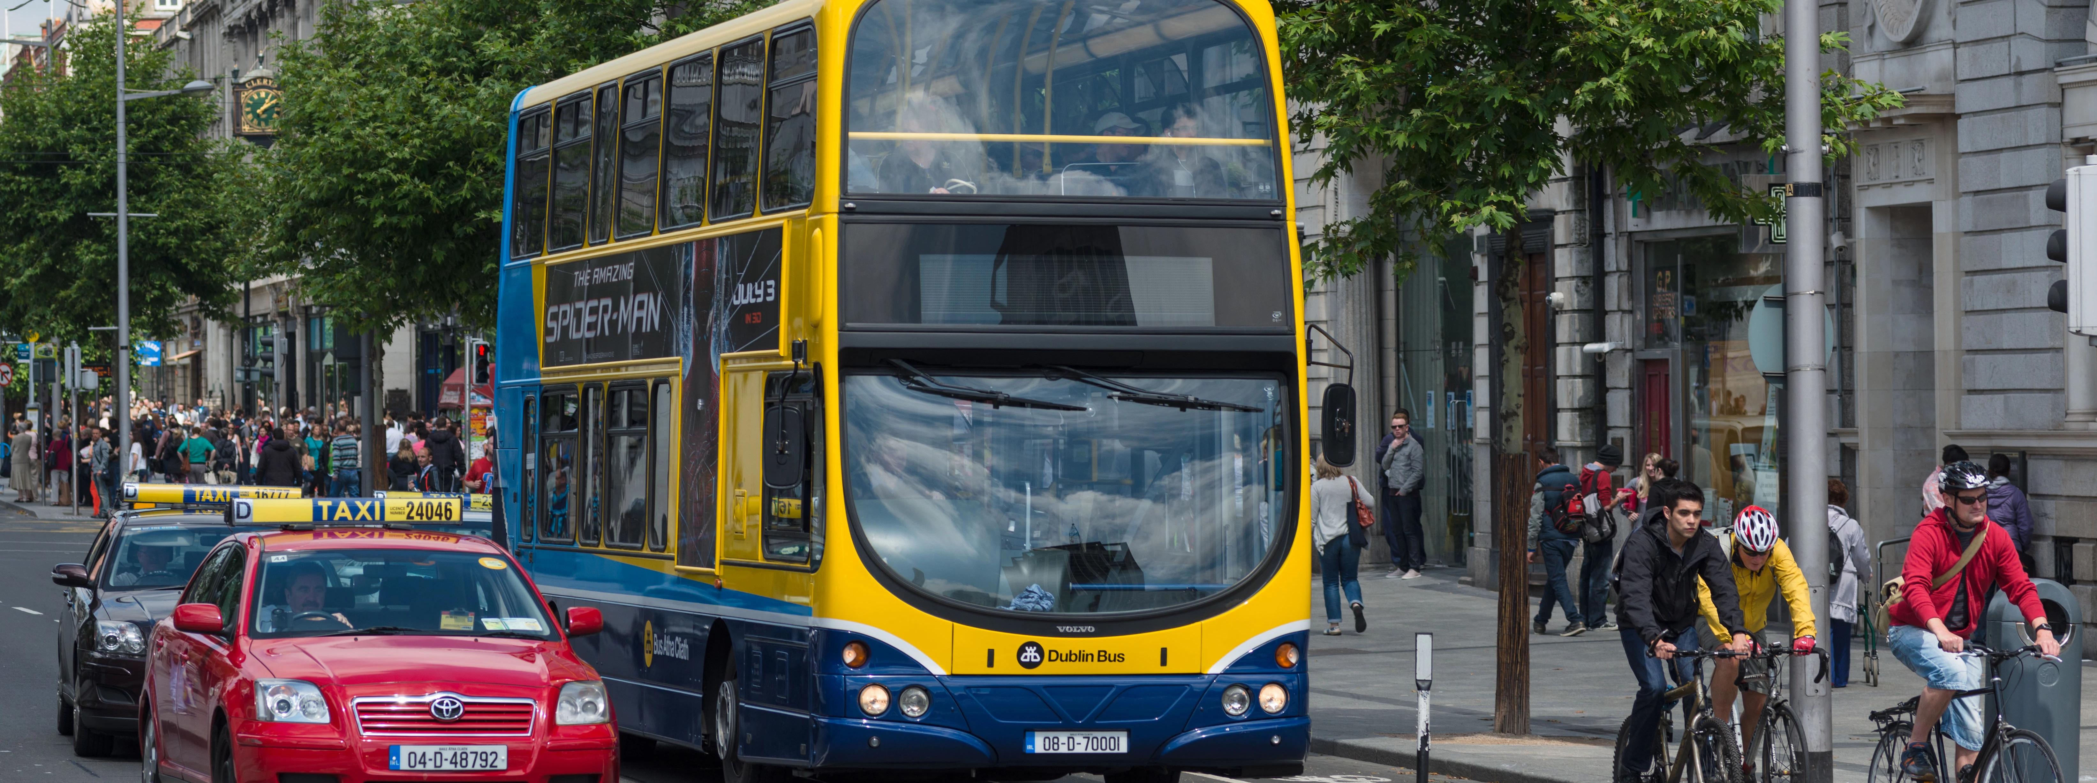
Getting Around
LEAP cards – Young Adult (<26) or Student (26+) https://www.leapcard.ie/
Dublin Bus
LUAS
DART
Dublin Bikes
Taxis
TFI Live App

Slide 6
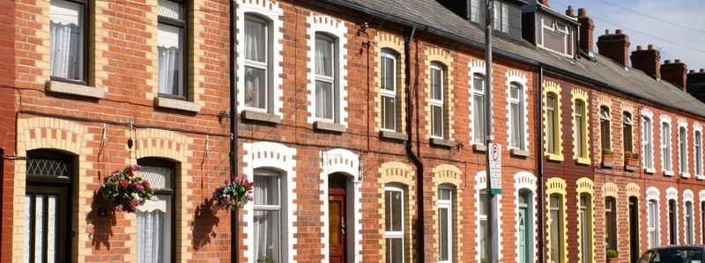
Renting
Accommodation Advisory Service
Threshold & RTB
Rights as tenants

Slide 7
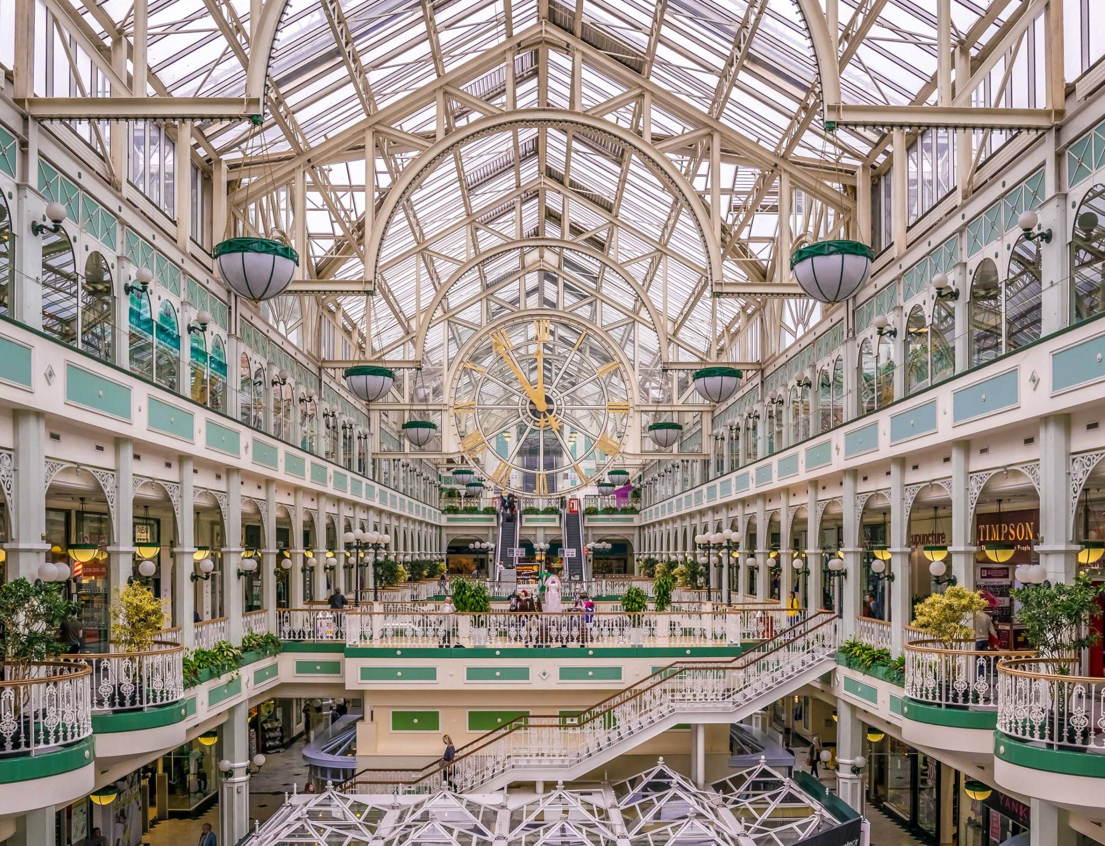
Shopping
Grocery shopping
  Budget: Lidl, Aldi
  Regular: Tesco, SuperValu, Dunnes Stores
  Specialty: Polish/Asian
  Convenience: Spar, Centra, Circle K, Londis, Mace
  Upmarket: Fallon & Byrne, Donnybrook Fair, Dollard & Co.
Clothes shopping
  Henry Street, Grafton Street, Dundrum SC
Household & Furnishings
  IKEA, Penneys, Dunnes

Slide 8
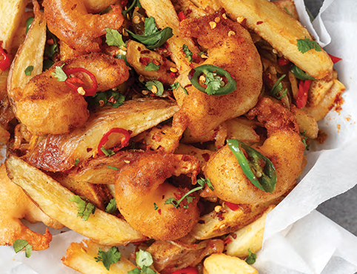
Eating Out, Delivery & Takeaways
Student discounts
Dublin restaurant scene
Deliveroo, JustEat, UberEats
Grocery delivery: buymie, shuppa, supermarkets

Slide 9
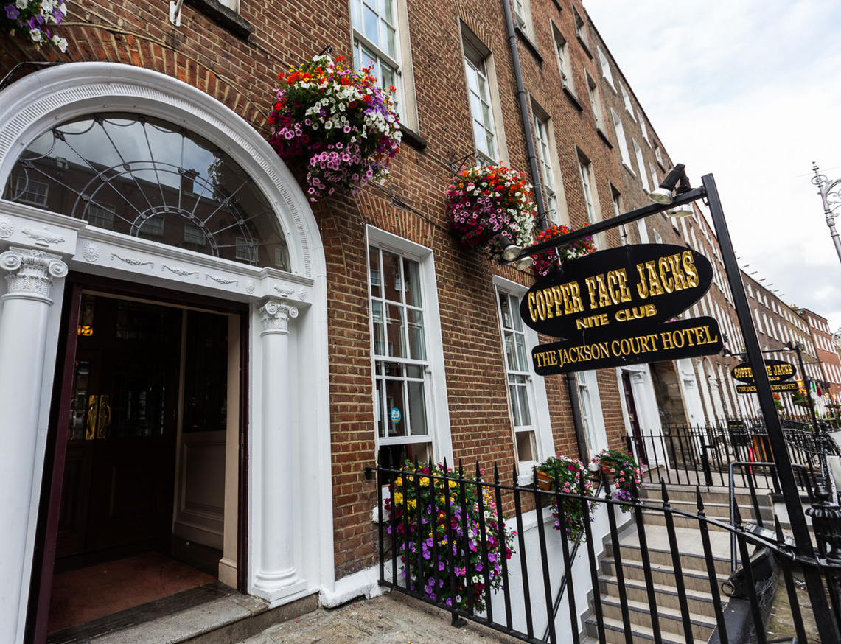
Things to do – Going Out
Pub culture
Opening hours
Rounds
Not drinking
Getting home
SU, Societies, Clubs, The Pav

Slide 10
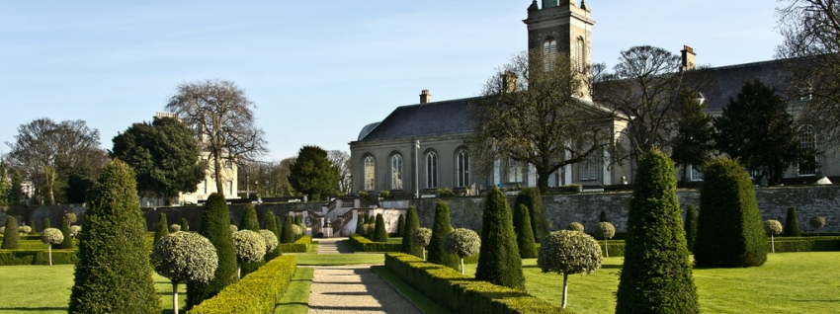
Things to do - Culture
Live Music
Cinemas
Cafes
Museums
Parks
Theatre

Slide 11

Travel
Bus Eireann
Irish Rail
Car rental
Student discounts
Ryanair
Aer Lingus
Visas

Slide 12
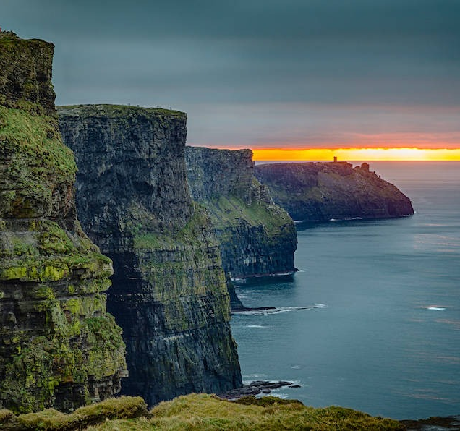
Travel Around Ireland
Nights out in Galway City
Surfing in Sligo and Donegal
The Wild Atlantic Way
Cross the Carrickarede rope bridge and visit the Giant’s Causeway in Antrim
Walking in Wicklow
The Cliffs of Moher and the Burren in Clare
The Lakes of Killarney and the Ring of Kerry
Newgrange in County Meath
Johnny Foxes in the Dublin Mountains
The murals in Belfast
The Blarney Stone & Fota Wildlife Park in Cork
The National Stud and the Japanese Gardens (and Kildare Village outlet mall) in Kildare
This Photo by Unknown Author is licensed under CC BY-SA-NC

Slide 13


Slide 14


Slide 15
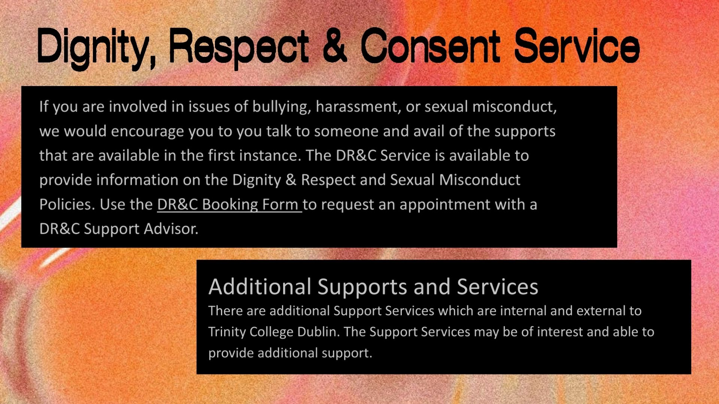

Slide 16
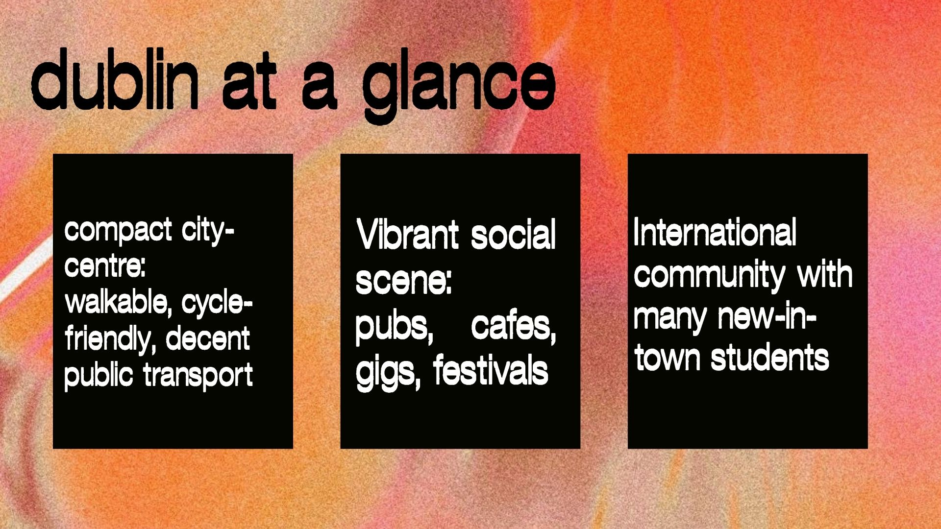

Slide 17
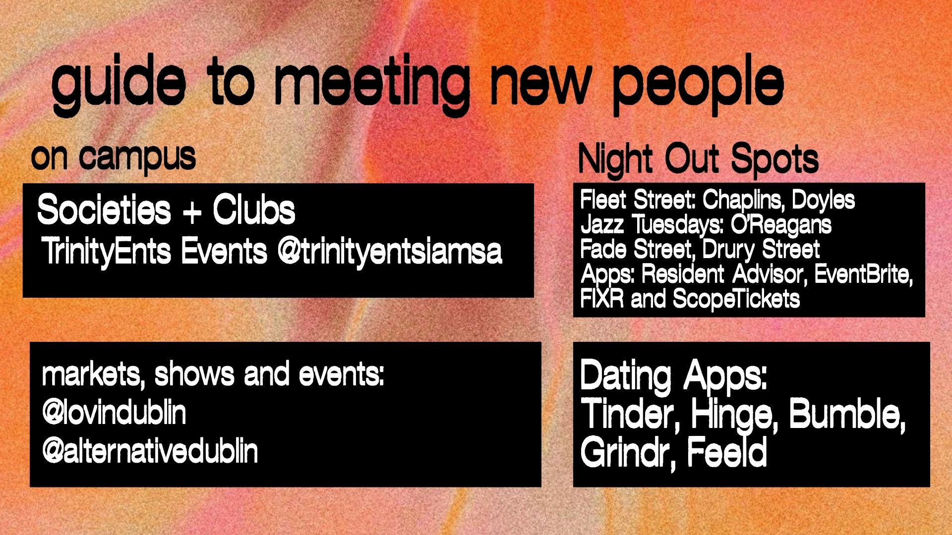

Slide 18


Slide 19


Slide 20


Slide 21
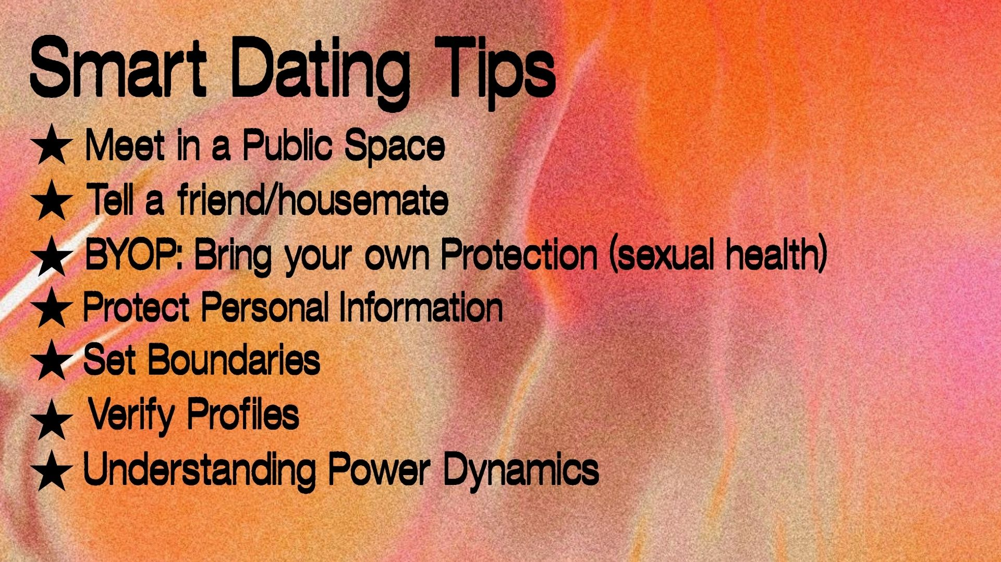

Slide 22
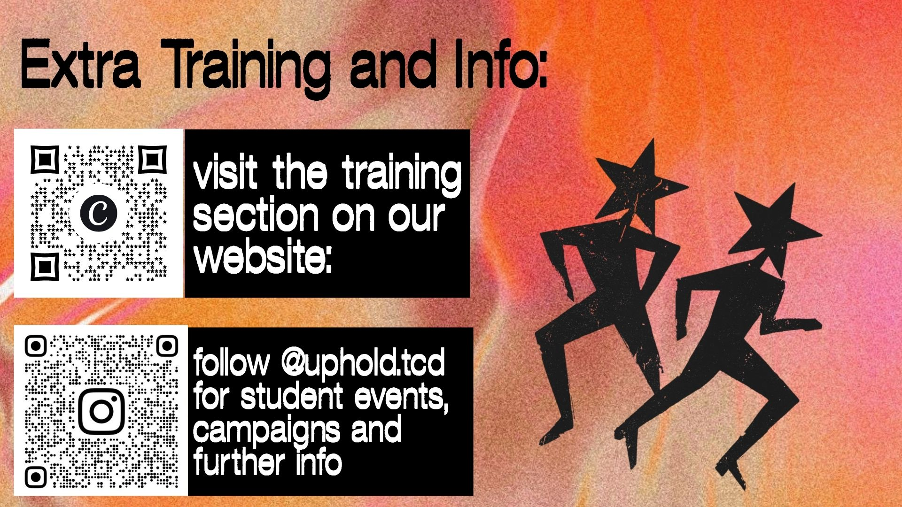

Slide 23
